Slide 1





Shield Insurance
Your Safety, Our Promise
Notes:
Hello everyone. This is Swetha. Today I am here to present my assignment which is the final part of my 4 weeks intensive internship from Codebasics. This project Shield Insurance has been assigned to me by AtliQ Technologies from an Insurance Domain.

Slide 2

Table Of Contents
01
02
03
Introduction
Mission & Vision
Suggestions
Notes:
We are going to discuss about the Who is Shield Insurance Company, What is their Mission & Vision and Suggestions to the company.

Slide 3

Introduction
Client Focused Approach: Shield Insurance is a leading insurance company which operates in five major Indian cities, makes it accessible for every individual.
Assorted Sales Modes: This provider utilizes different sales channels to reach a wide customer base.
Diverse Insurance Plans: This company offers a wide range of unique insurance policies to meet the different needs of its clients.
Versatile Age Groups: Shield Insurance offers a broad variety of policies tailored for various age groups.
Notes:
Shield Insurance Company is who every Individual and Business can trust. They have a clear vision on how to approach the Client, as a part of which they are currently operating in five major cities in India. They operates through an assorted Sales Modes, which includes both Online and Offline. Shield Insurance company offers Diverse Insurance Plans, Broad variety of Policies tailored to the versatile Age Groups(18-100) which makes it accessible for every individual.

Slide 4

Mission
Vision
Shield Insurance is committed to leveraging data-driven insights to enhance decision-making. Through a pilot Power BI project with AtliQ Technologies, we aim to evaluate the effectiveness of a dashboard solution that provides key performance indicators. This initiative serves as a proof of concept, ensuring that our unique requirements are met before full-scale implementation.
To establish a long-term partnership that empowers Shield Insurance with cutting-edge analytics, enabling smarter, more informed decisions. By adopting advanced dashboard solutions, we strive to enhance operational efficiency and drive sustainable growth through data-driven strategies.
Notes:
What is their Mission – Shield Insurance is testing a new Power BI dashboard with AtliQ Technologies to see if it helps make better decisions using data. This trial will show if the dashboard meets our needs before we use it on a larger scale.
Now coming to the Vision - By using smart dashboards, this company aims to improve efficiency and support long-term growth with data-driven strategies.

Slide 5
Overview of Pages
01
02
03
General Analysis
Sales Mode Analysis
Age Group Analysis
Notes:
The Shield Insurance Power BI Project is explained through 3 main pages- General Analysis, Sales Mode Analysis and Age group Analysis pages.

Slide 6

Welcome To The Live Presentation
I’m Swetha, and I'll be providing you with my in-depth evolution and insights of Shield Insurance’s performance.

Slide 7

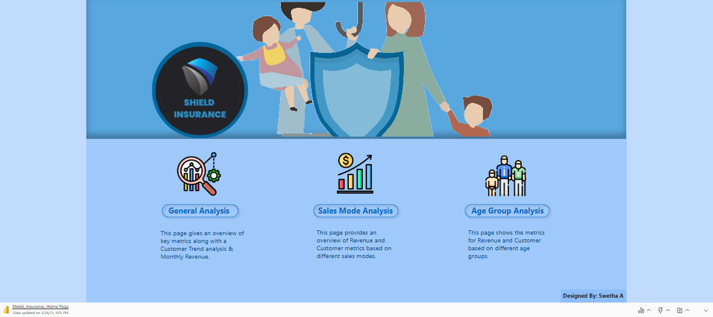
Notes:
This is landing page of our Shield Insurance Power BI Project.
Moving on to our first page which is General Analysis Page –
We have mainly 4 Key Metrics which are Total Revenue, Total Customers, Daily Customer Growth, Daily Revenue Growth.

Slide 8


Suggestions
City Prioritizing: Indore and Chennai are the wo main cities which needs to focused on improving customer engagement and revenue growth. Use targeted marketing efforts, special promotions, and personalized customer interactions to attract more people, keep them engaged, and encourage repeat business.
Connect with young adults: Raise awareness and adjust marketing strategies to better connect with and appeal to this group of people who are not well-represented. Focus on understanding their needs, preferences, and interests to create messages and campaigns that genuinely resonate with them.
Focus on Digital Channels: Take advantage of the increasing popularity of buying and selling products online through mobile apps and websites. More people are shopping digitally, so businesses can benefit by creating user-friendly platforms that make it easy for customers to browse, purchase, and interact with their products or services.
Revitalize Offline Sales: Figure out why in-person sales are dropping and take steps to fix it. This could mean looking into things like changing customer preferences, stronger online competition, or issues with pricing. At the same time, improve the way sales agents are rewarded—maybe through better commissions, bonuses, or other incentives—so they feel more motivated to boost their sales.
Notes:
Indore and Chennai are the lacking behind in terms of policies, so these cities should primarily focus on marketing efforts, special promotions in order to attract more people and for the eventual business growth.
Connecting with young adults prominently raise awareness. Focus on understanding their preferences in order to the current marketing strategies.
Take advantage of buying and selling products online through apps and website. Digital shopping is the best way to attract more customers. Create user-friendly platforms which makes easy for the customers and to interact with the products. So focusing on Digital Channels could benefit in enormous growth of Business.
As in-person sales are dropping, we need to revitalize Offline sales by rewarding sales agents through better commissions and other incentives, to make them feel more motivated which in turns helps to boost their sales.

Slide 9




Contact Information:
For further inquiries or to sign up for our Shield Insurance plan, please reach me at:

Slide 10
Thank You!

